Slide 1
Case 1. “Can’t Shock What You Can’t See”
70M with history of ESRD found unresponsive on the floor. No pulse.
CPR in progress, IV access obtained.

Slide 2
Case 1. “Can’t Shock What You Can’t See”
POC Glucose: 98 mg/dL
hs-TnI: 11,000 ng/L
ABG | Result | Reference Range
pH | 6.98 | 7.35–7.45
pCO₂ | 55 mmHg | 35–45 mmHg
pO₂ | 88 mmHg | 80–100 mmHg
HCO₃⁻ | 12 mmol/L | 22–26 mmol/L
Lactate | 9.2 mmol/L | <2.0 mmol/L
Na⁺ | 138 mmol/L | 135–145 mmol/L
K⁺ | 7.2 mmol/L | 3.5–5.0 mmol/L
Cl⁻ | 105 mmol/L | 98–106 mmol/L
iCa²⁺ (ionized) | 0.98 mmol/L | 1.12–1.32 mmol/L
Glucose (repeat) | 94 mg/dL | 70–100 mg/dL
Notes:
Role-play how residents should communicate lab findings quickly to influence ACLS management.
Severe metabolic acidosis (low pH, HCO₃⁻), likely from lactic acidosis and hypoperfusion.
Hyperkalemia (6.9) → treat urgently
Mild hypocalcemia, which may contribute to cardiac instability.

Slide 3
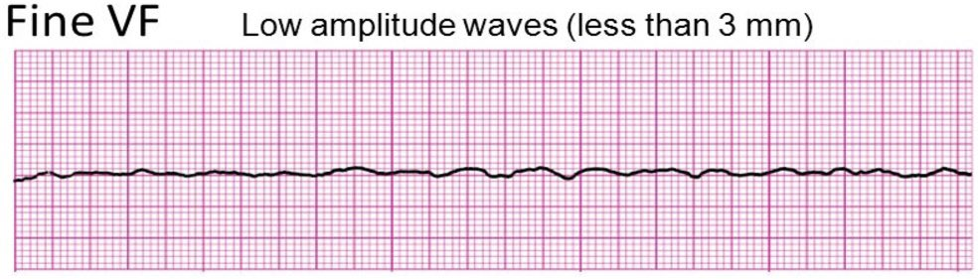
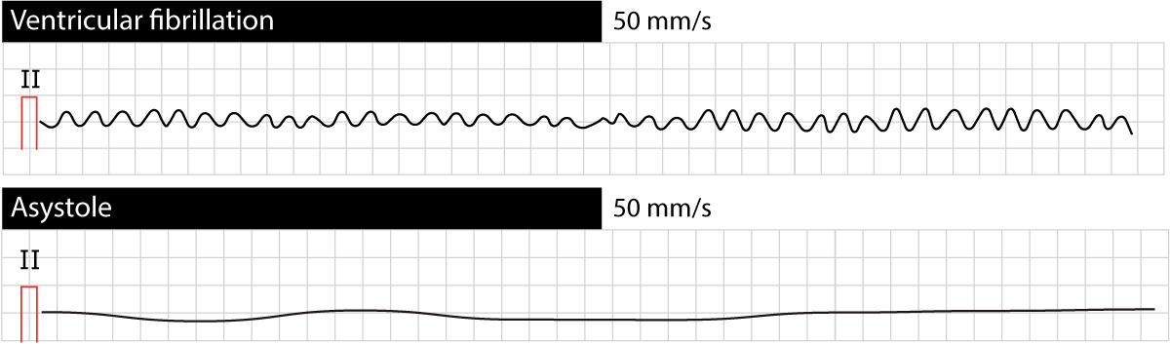
Case 1. “Can’t Shock What You Can’t See”

Slide 4
Case 2. “Pulseless but Not Powerless”
58F with history of CAD s/p multiple remote DES, HLD, T2DM, Active smoker now admitted for UTI with sepsis. Telemetry alarms "code blue" on hospital day 2.
On initial assessment, pulses are absent.

Slide 5
Case 2. “Pulseless but Not Powerless”
POC blood glucose: 152 mg/dL
hs-TnI: 121 ng/L (Normal <50 ng/L)
ABG |  | Reference Range
pH | 7.18 | 7.35–7.45
pCO₂ | 48 mmHg | 35–45 mmHg
pO₂ | 64 mmHg | 80–100 mmHg
HCO₃⁻ | 16 mmol/L | 22–26 mmol/L
Lactate | 6.5 mmol/L | <2.0 mmol/L
Na⁺ | 137 mmol/L | 135–145 mmol/L
K⁺ | 4.9 mmol/L | 3.5–5.0 mmol/L
Cl⁻ | 103 mmol/L | 98–106 mmol/L
iCa²⁺ (ionized) | 1.10 mmol/L | 1.12–1.32 mmol/L
Notes:
Interpretation:
High lactate + metabolic acidosis = post-arrest hypoperfusion.
pO₂ low = poor oxygenation during arrest (likely cause/contributor to VF).
No major electrolyte abnormality (mild hyperkalemia is expected post-VF).
Ionized calcium at low-normal – may worsen if CPR continues.

Slide 6
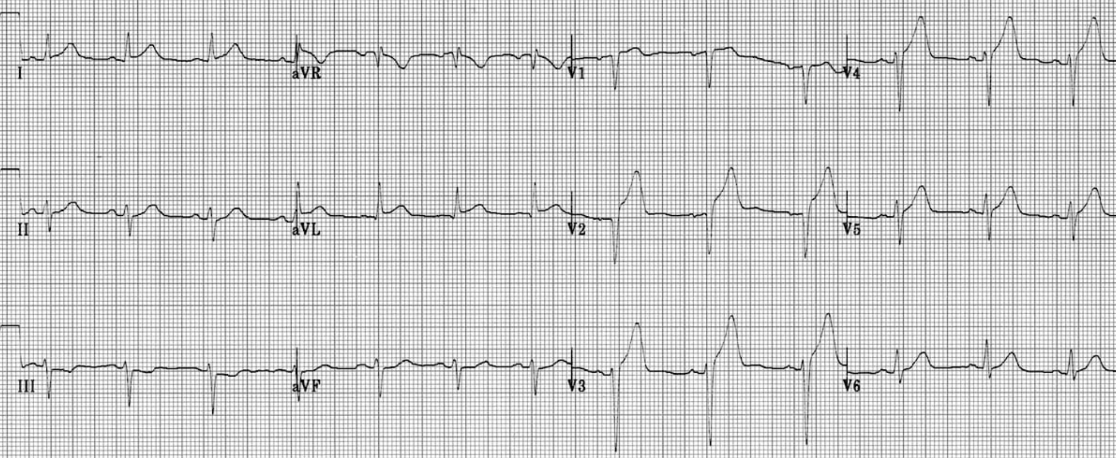
Case 2. “Pulseless but Not Powerless”
Post-ROSC EKG:
Notes:
Anterior STEMI, which typically involves blockage of the left anterior descending artery (LAD), is the most common type of STEMI associated with ventricular fibrillation (VF).

Slide 7
Case 3: “No Pulse, Wide QRS”
45M with HFrEF collapses in clinic waiting room. Code is called. Initial assessment reveals absent pulses.

Slide 8
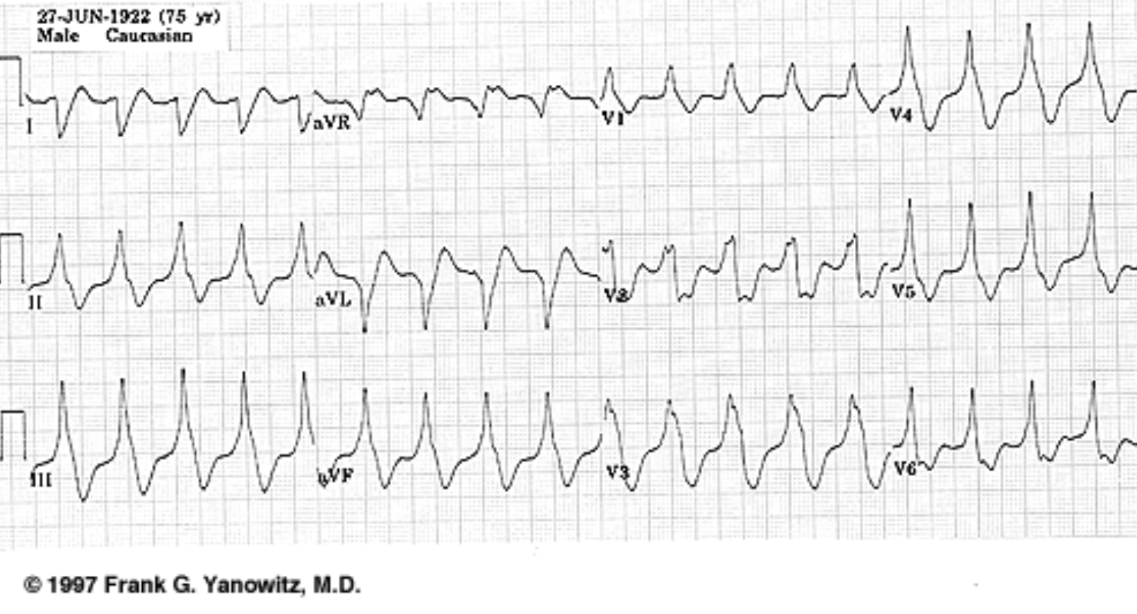
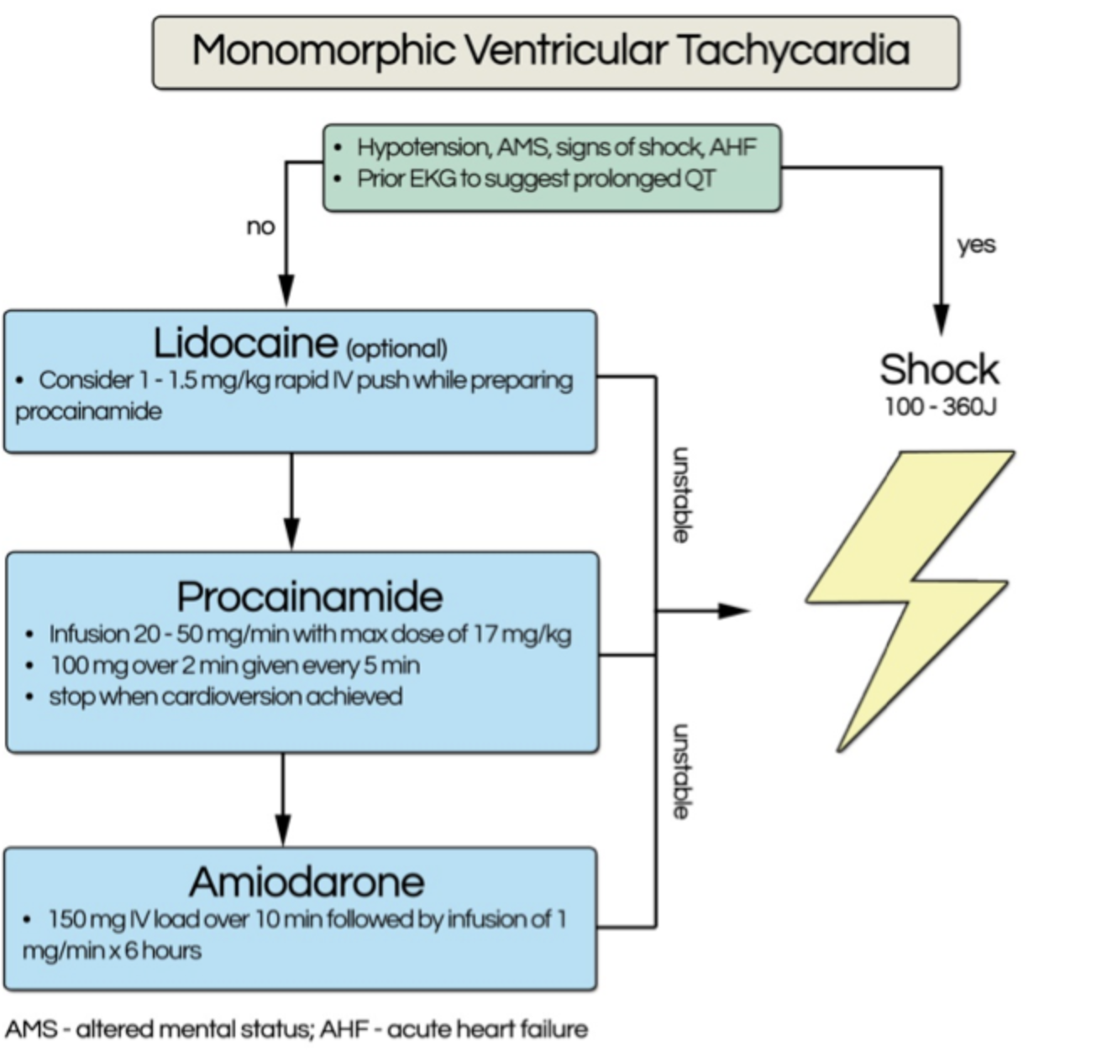
Case 3: “No Pulse, Wide QRS”

Slide 9
Case 4: “Fast & Faint”
36F admitted for ETOH detox. RRT activated on third day of admission. Tachycardic, HR 180s, dizzy/lightheaded but responsive, pulsatile in all ext.

Slide 10
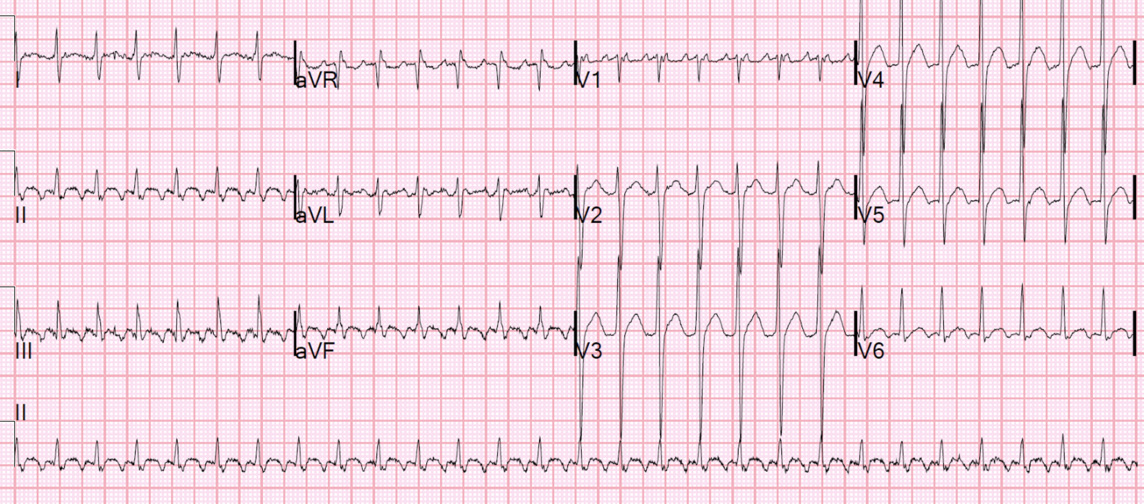
Case 4: “Fast & Faint”
Initial EKG

Slide 11
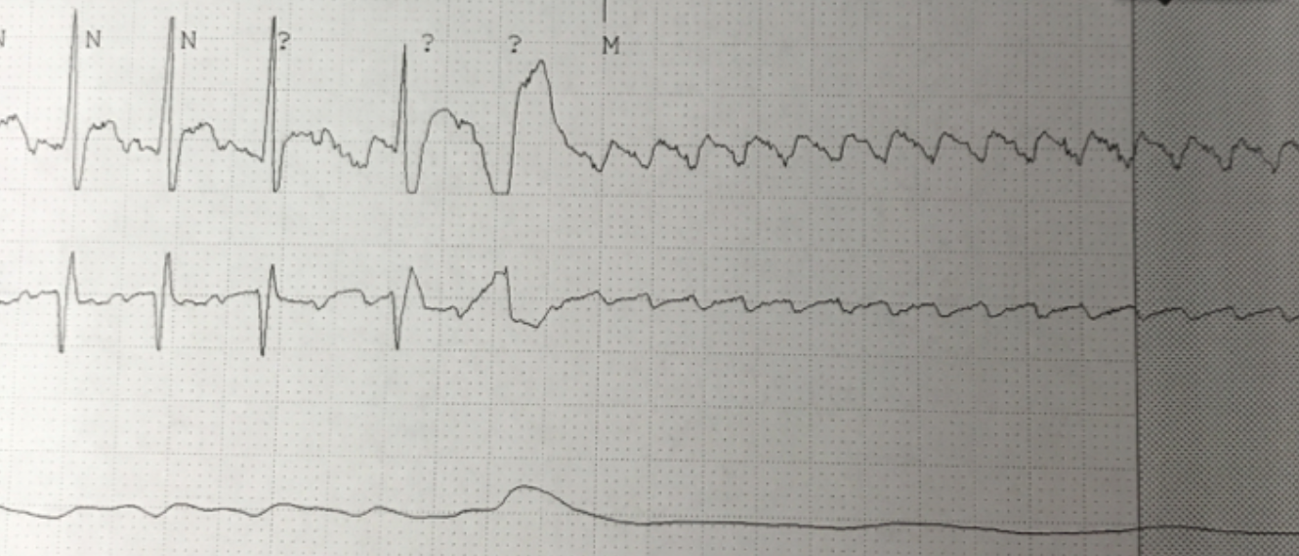
Case 4: “Fast & Faint”
Post Adenosine Tele:
Baseline Rhythm?
The AV node is blocked by adenosine and QRSs disappear. This "reveals" the flutter waves, which of course continue. There are some ventricular escape beats.
The half-life of adenosine is about 10 seconds
Atrial flutter with 2:1 conduction.
It is not PSVT and not sinus

Slide 12
Case 5: “Slow and Confused”
82F with bradycardia, confusion, SBP 80s. RRT activated for bradycardia

Slide 13
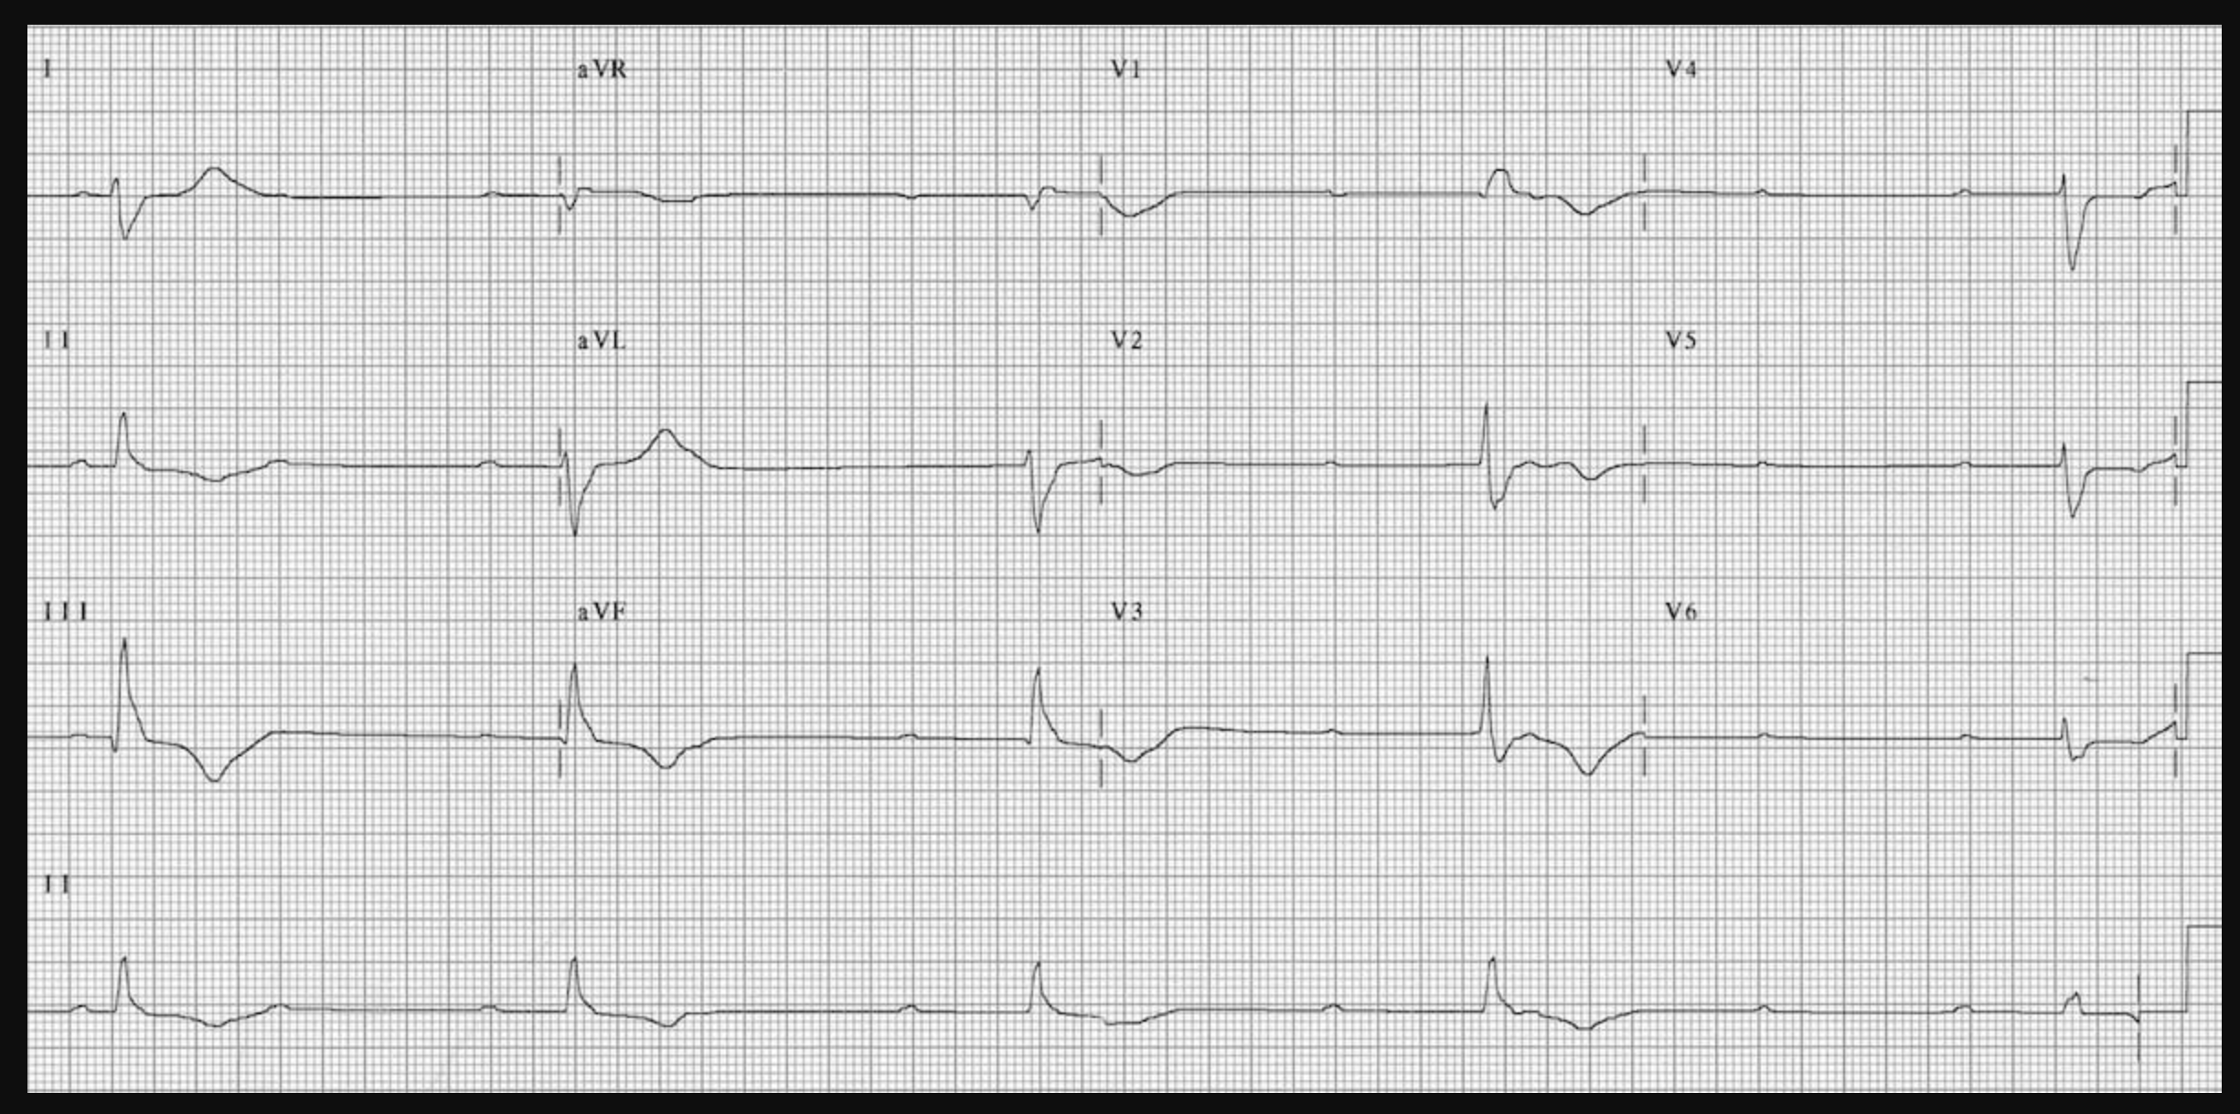
Atrial Rate?
Ventricular Rate?
60 bpm
None of the atrial impulses appear to be conducted to the ventricles
There is a slow ventricular escape rhythm
27 bpm

Slide 14
Case 6: “Twist and Shout”
24F with recent QT-prolonging meds collapses on telemetry.

